Slide 1

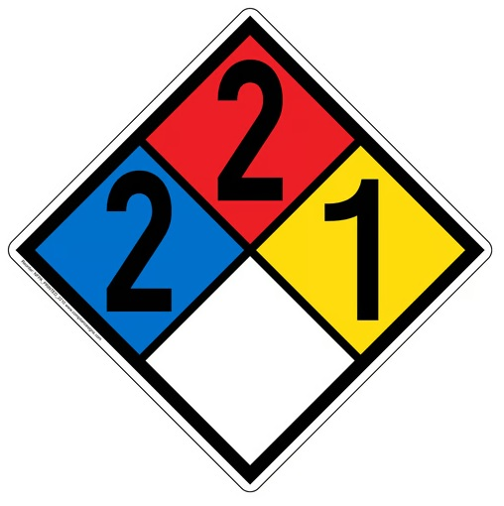
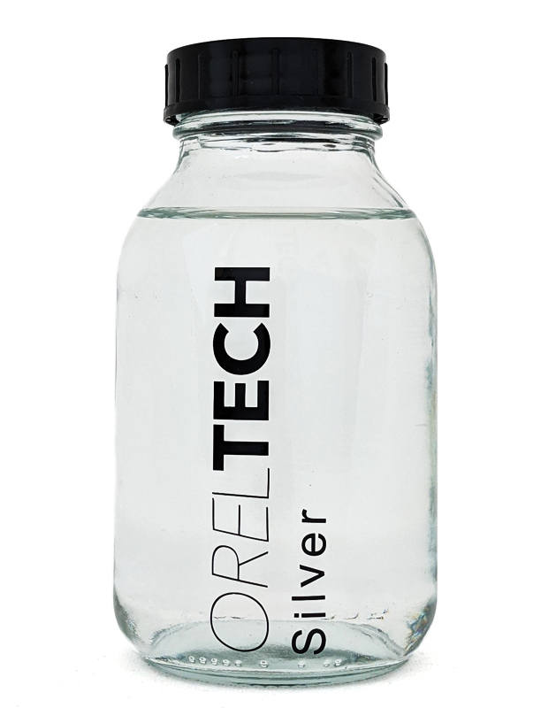
OTech Jet - Silver Ink for Highly Conductive Electrodes Data Sheet
Product description
OrelTech’s unique process allows printing and aerosol spraying of highly conductive silver thin films. Printed layers undergo short development (curing) using plasma treatment resulting in a thin fine silver structure. OrelTech inks do not contain nanoparticles and are significantly environmentally friendlier than the alternatives on the market. Lack of nanoparticles also allows them to be much more cost-effective than other conductive inks.
Benefits
Precise patterning by inkjet or aerosol jet printing
Low temperature process
Printed on polymers, glasses, metals and active materials
No solid or liquid waste
Environmentally friendly
Cost-efficient solution
Typical properties of the ink
OTech Jet
Viscosity, cP | 5 – 30*
Shelf life, 25⁰C | 12 month
Cure type | Cold plasma
Application method | Inkjet, aerosol jet
Example print heads | KM 512, Samba, Xaar, Epson DX5, single nozzle
Substrate | Plastic, paper, glass, PV stack
Appearance | Clear liquid
Applications | ● EMI shielding ● Radio frequency (RF) ● Wireless components ● Memory ● Sensors ● Other sensitive devices
* Depending on the application method. Custom formulations are available.
Downloaded from oreltech.com
For additional questions please contact konstantin@oreltech.com

Slide 2
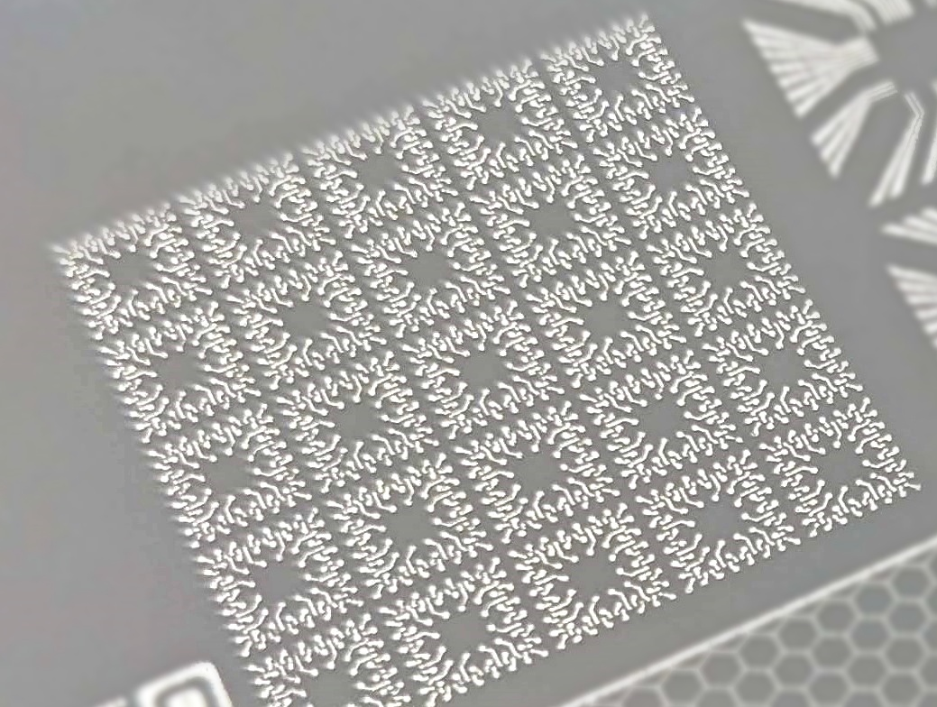
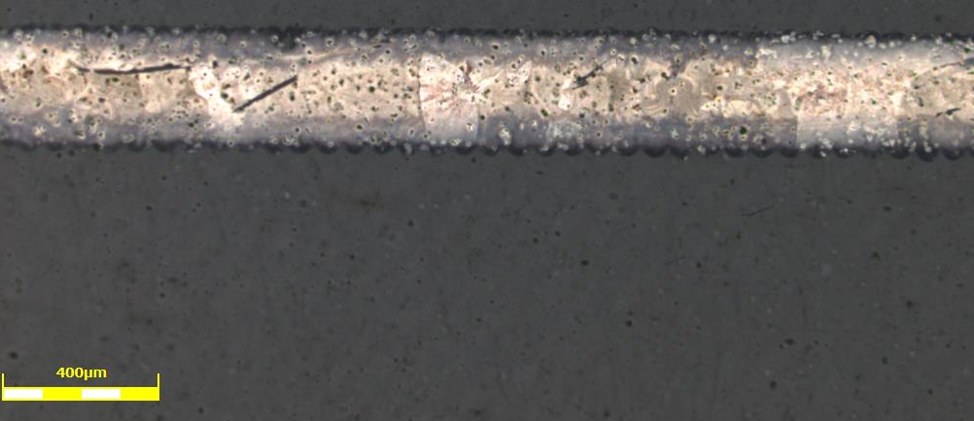
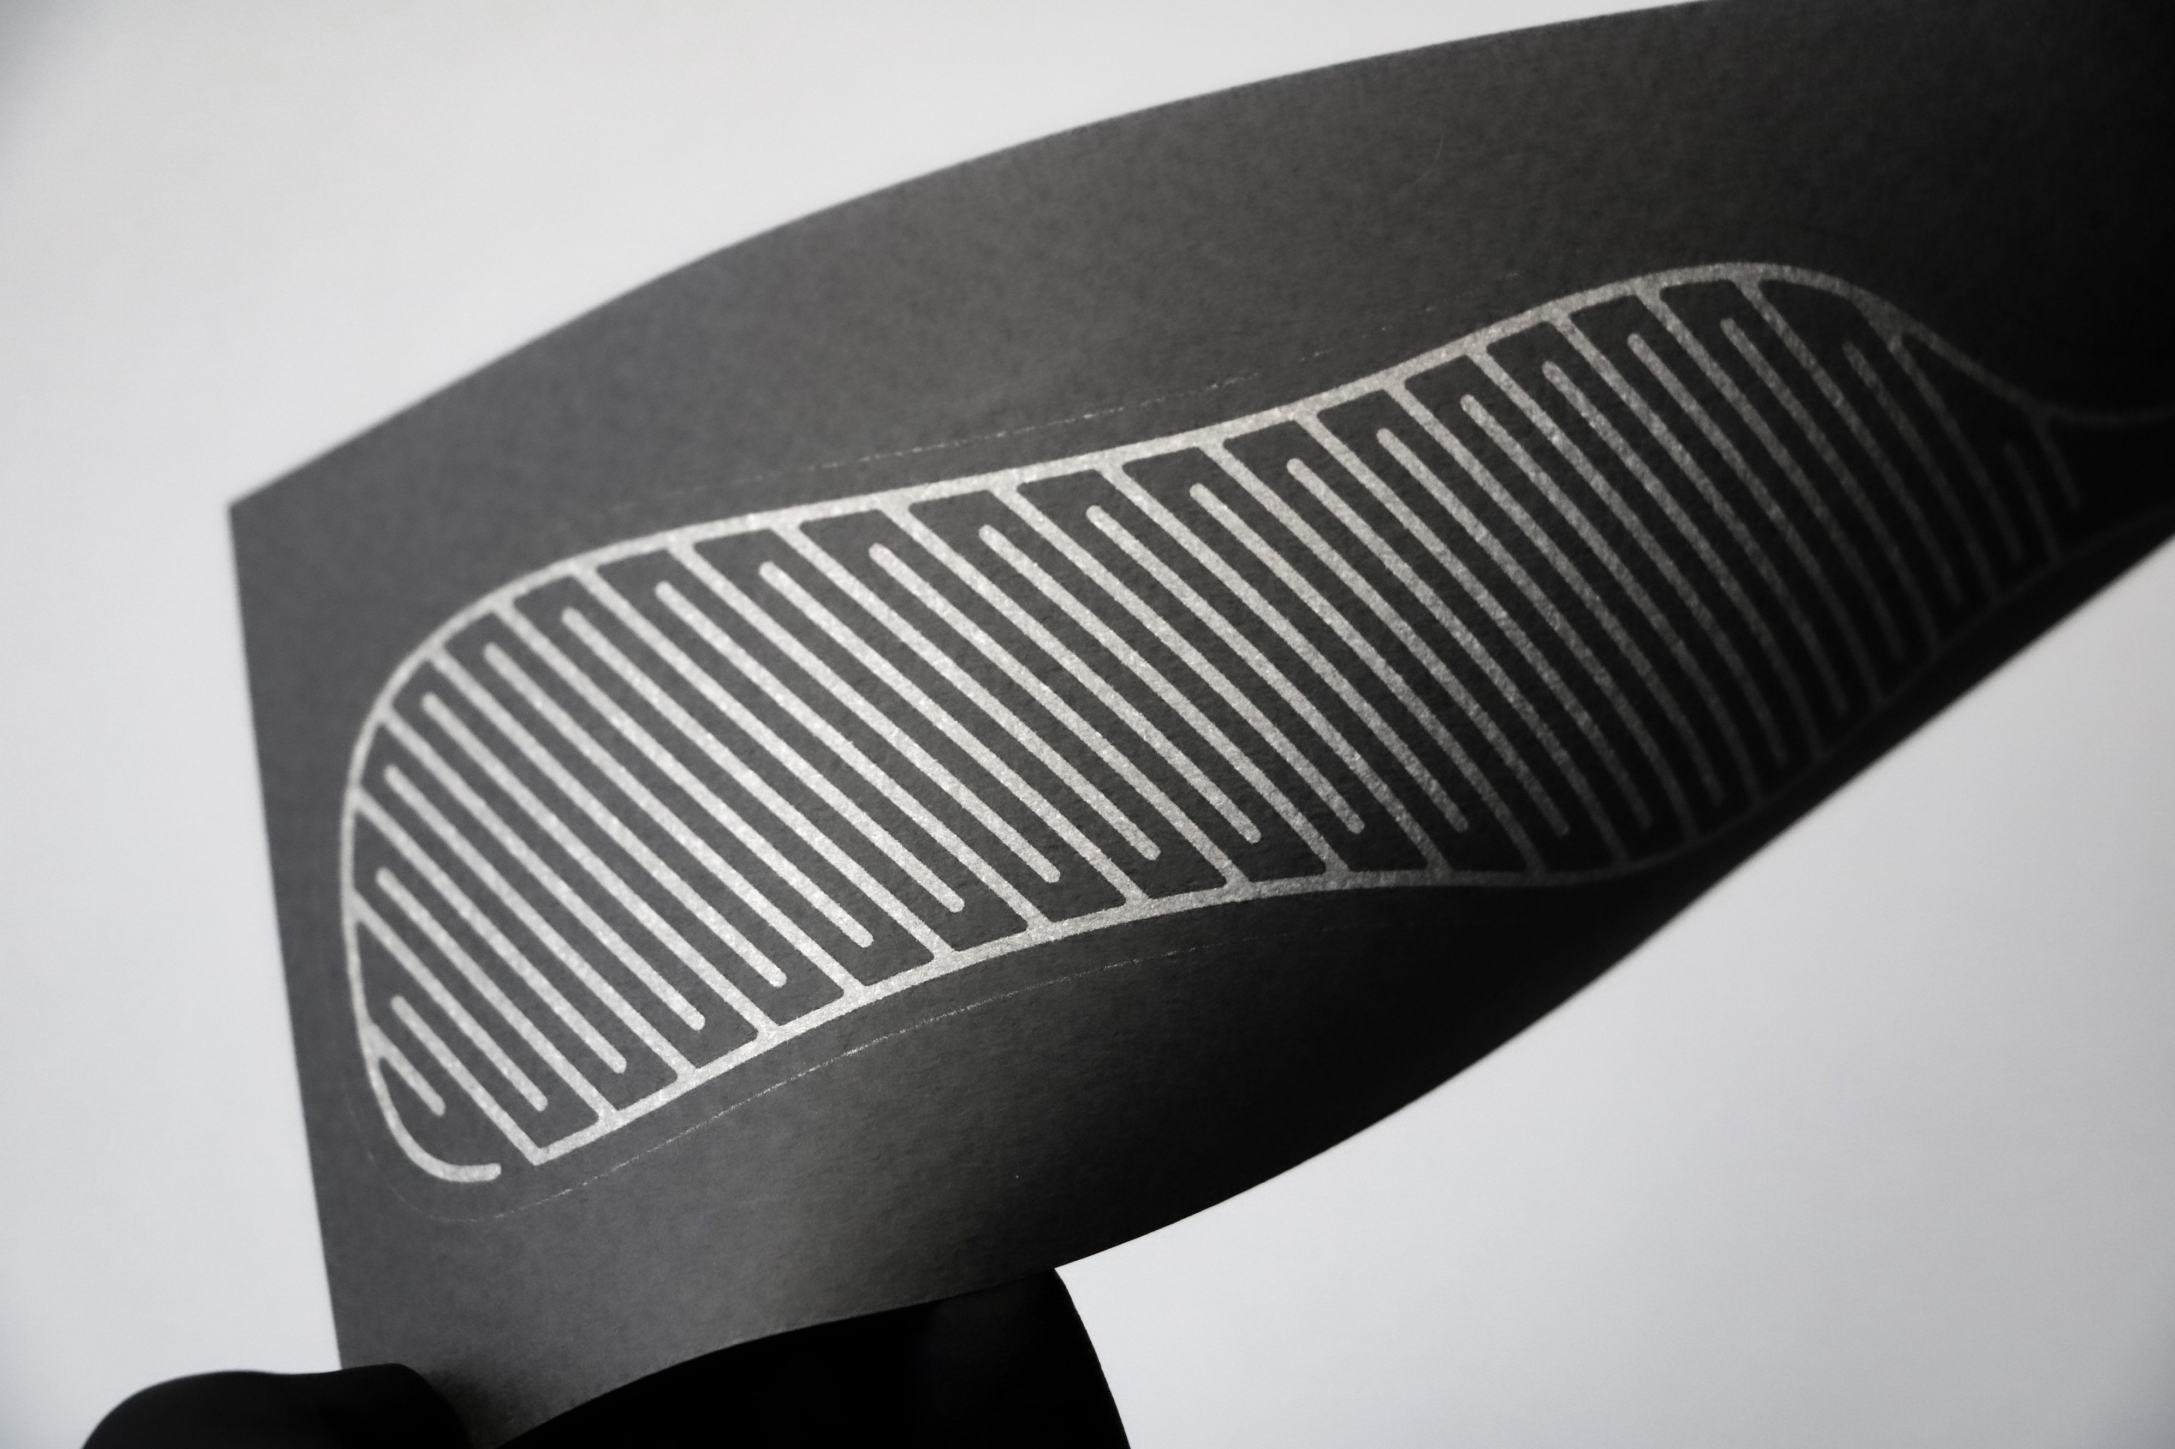
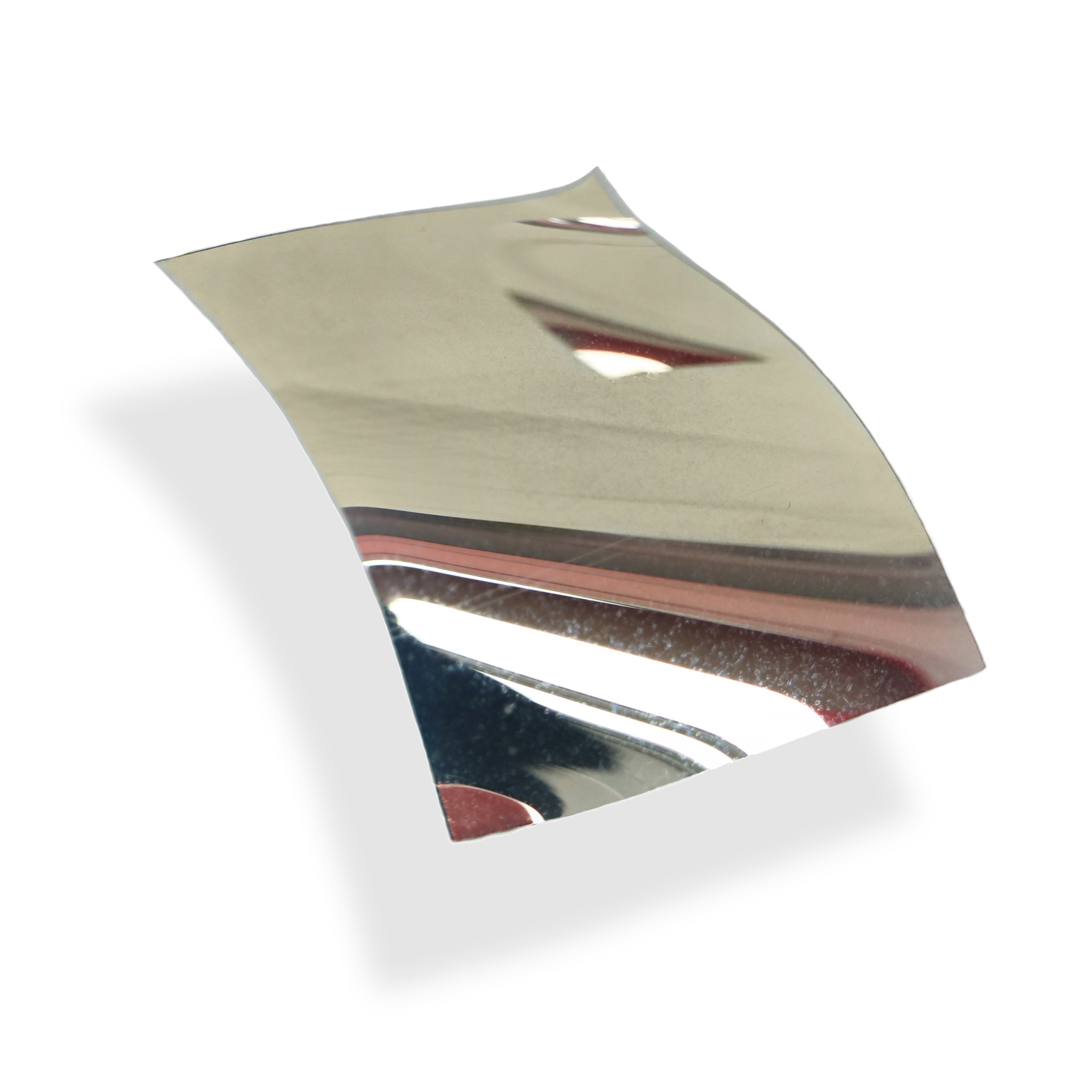
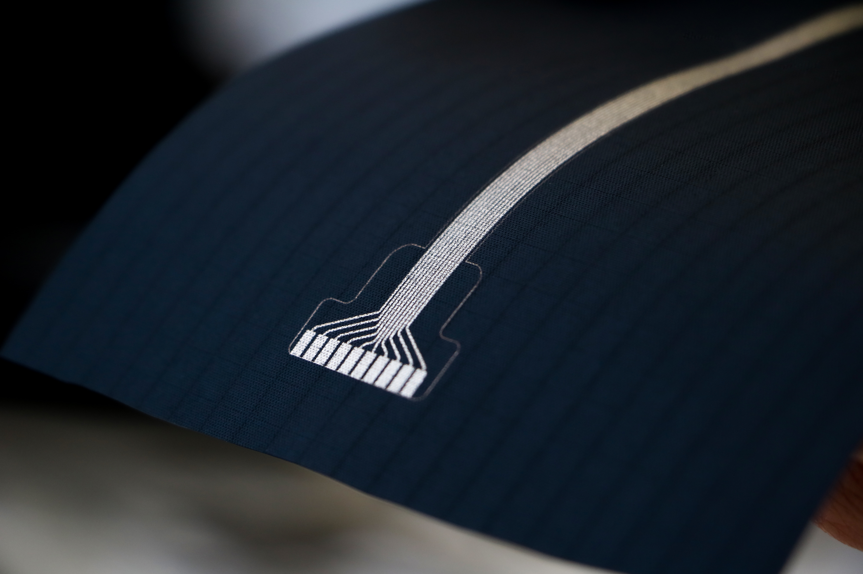
Directions for use and storage
● Storage: Inks can be stored in closed containers for up to 12 month in dry, dark conditions.
● Clean-up: Materials can be cleaned up using alcohols and ketones, preferably isopropanol.
● Pre-treatment: In some cases, to ensure better wettability and/or adhesion, the substrate material must be pre-treated prior to ink application.
Curing conditions
● Curing time: 1-5 minutes.
● Curing apparatus: Cold plasma instrument with a low-pressure chamber (0.3-0.5 mbar).
● Curing temperature: Temperature in the plasma chamber does not exceed 70 ⁰C. No additional heating is needed. That temperature can be lowered to room temperature using a temperature-controlled plasma chamber.
Typical properties of the cured film
Conductivity, % bulk | 30 – 55
Resistivity, µΩ·cm | 5.6 – 2.9
Sheet resistance, Ω/□ | 0.1 – 3
Adhesion | Tested on PET, PI, PC, PEN, others
Layer thickness, nm | 100– 1500
Printed OTech Jet silver electrode on PET
Printed OTech Jet silver electrode on PET
Printed OTech Jet silver electrode on paper
Printed OTech Jet silver mirror electrode on PET
Printed OTech Jet silver electrode on textile
Downloaded from oreltech.com
For additional questions please contact konstantin@oreltech.com

