Slide 1


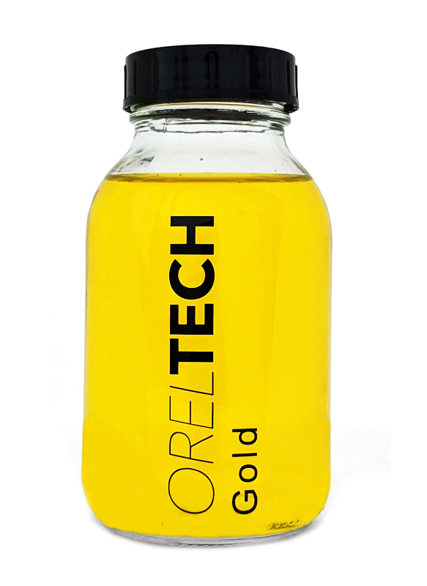
OTech Aurum - Gold Ink for Highly Conductive Electrodes Data Sheet
Product description
OrelTech’s unique process allows printing and aerosol spraying of highly conductive gold thin films. Printed layers undergo short development (curing) using plasma treatment resulting in a thin fine pure gold structure. OrelTech inks do not contain nanoparticles and are significantly environmentally friendlier than the alternatives on the market. Lack of nanoparticles also allows them to be much more cost-effective than other conductive inks.
Benefits
Coating and patterning by inkjet, aerosol or slot-die printing
Low temperature process
Printed on polymers, metals and fabrics
Pure gold layers, no additives, good biocompatibility
No solid or liquid waste
Material saving
Cost-efficient solution
Biocompatible and non-toxic
Typical properties of the ink
OTech Aurum
Viscosity, cP | 3 – 20*
Shelf life, 25⁰C | 12 month
Cure type | Cold plasma
Application method | Inkjet, slot-die, aerosol
Example printheads | Samba, single nozzle
Substrate | Plastic, paper, glass, fabric
Appearance | Clear yellow liquid
Acidity | pH > 2
Applications | Sensors Electrodes Medical devices Calalysis Other sensitive devices
* Depending on the application method. Custom formulations are available.
Downloaded from oreltech.com
For additional questions please contact konstantin@oreltech.com

Slide 2
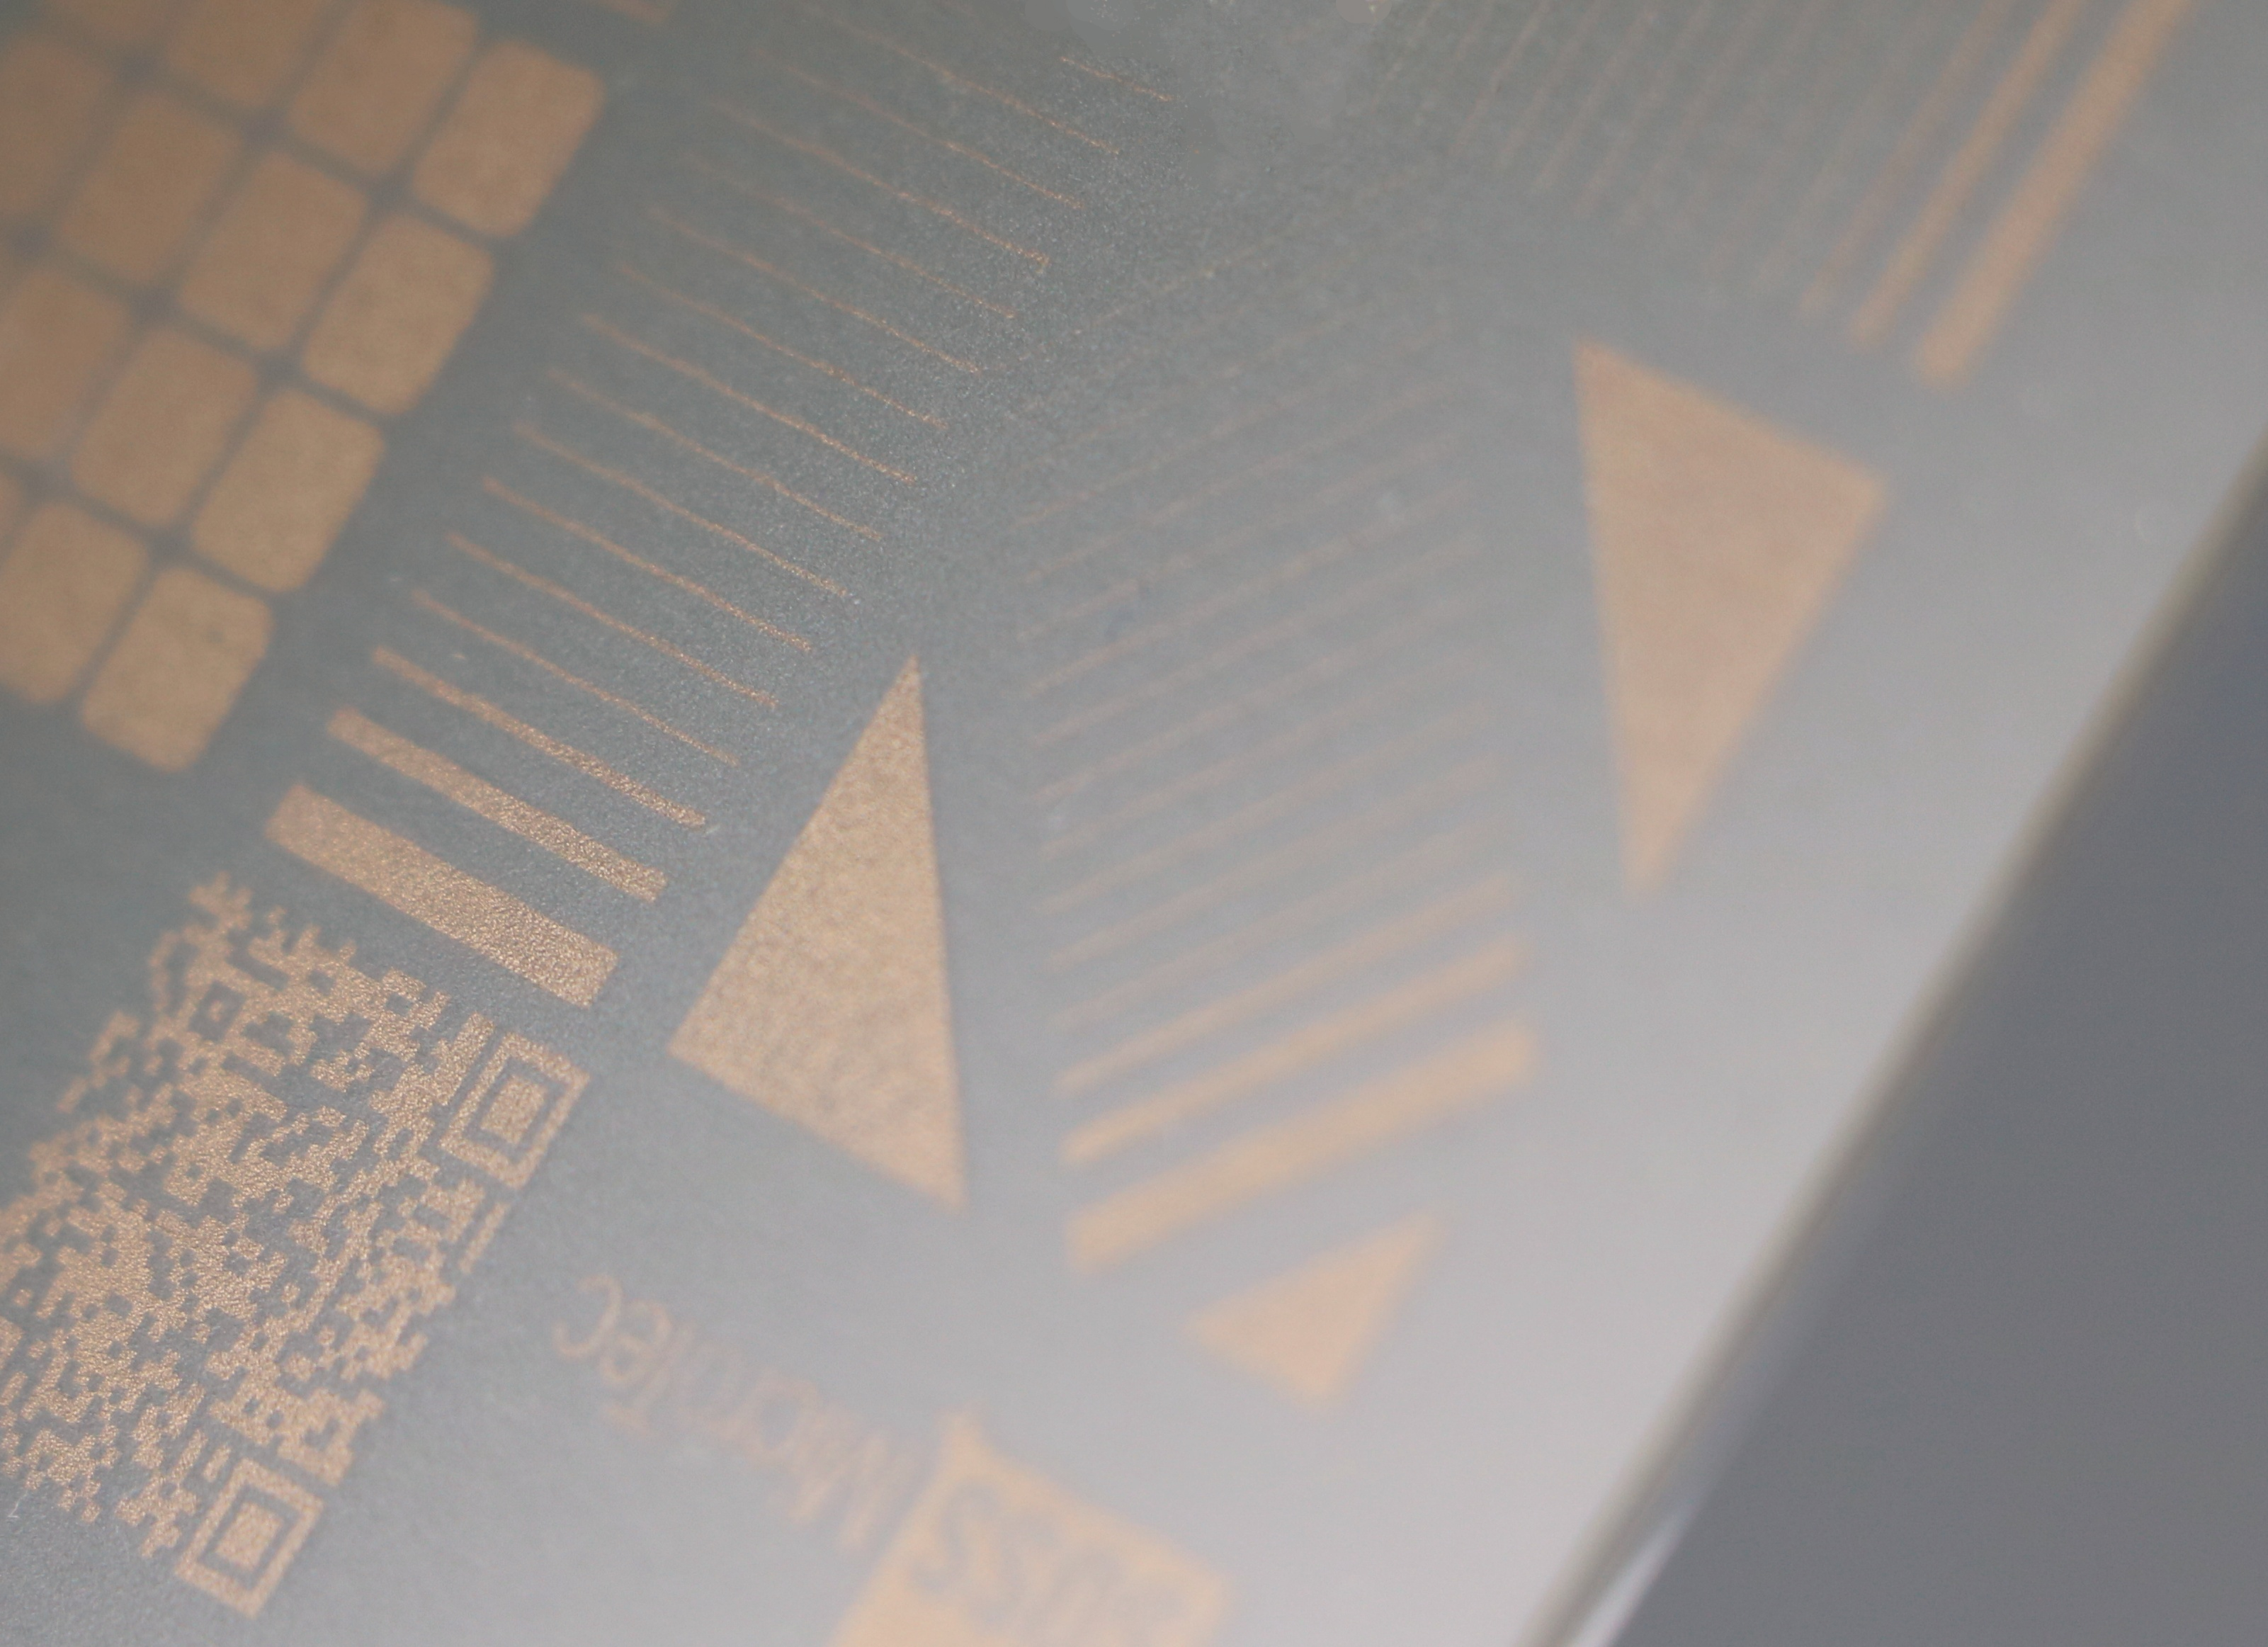
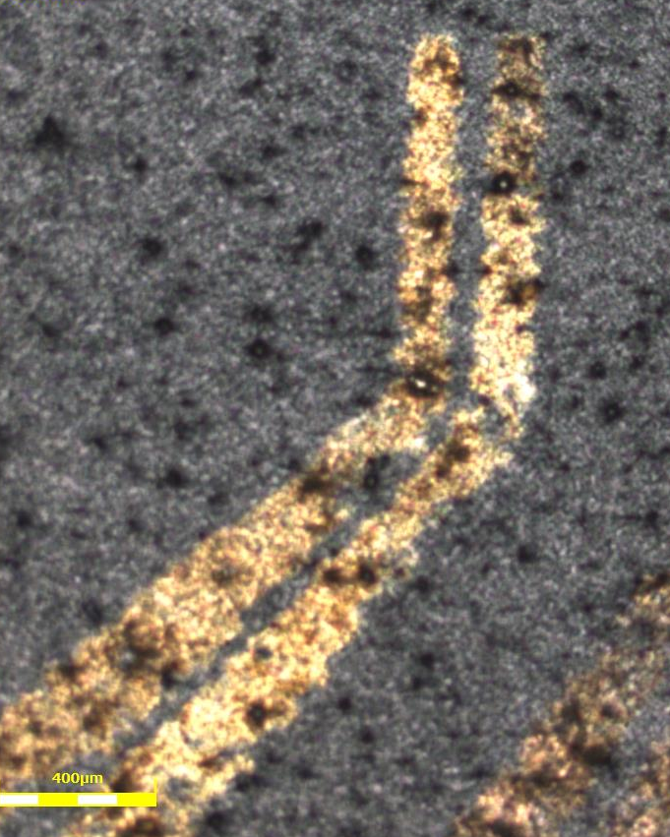
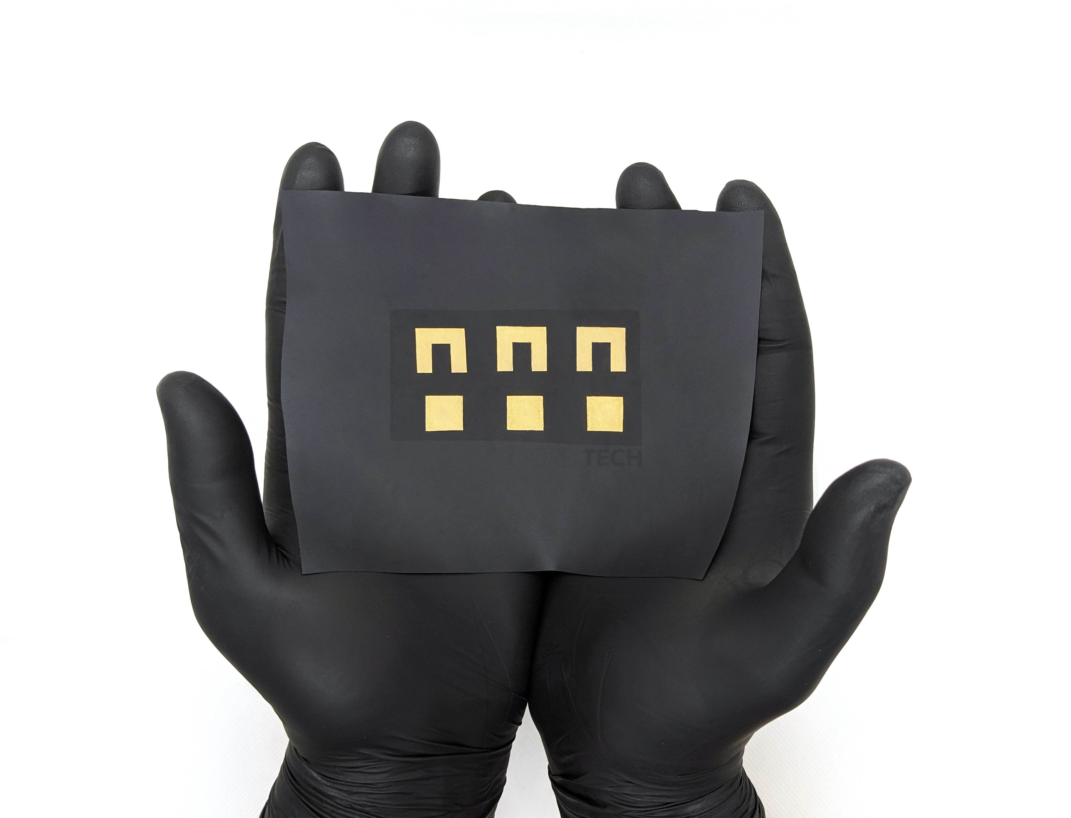
Directions for use and storage
● Storage: Inks can be stored in closed containers for up to 12 month in dry, dark conditions.
● Clean-up: Materials can be cleaned up using alcohols and ketones, preferably isopropanol.
● Pre-treatment: In some cases, to ensure better wettability and/or adhesion, the substrate material must be pre-treated prior to ink application.
● Handling: Please note that the ink is acidic (pH > 2). Use gloves and protective goggles, avoid direct skin contact. In some cases (fabric substrates) there is a need to rinse the substrate after the metallization process.
Curing conditions
● Curing time: 10-15 minutes.
● Curing apparatus: Cold plasma instrument with a low-pressure chamber (0.3-0.5 mbar).
● Curing temperature: Temperature in the plasma chamber does not exceed 70 ⁰C. No additional heating is needed. That temperature can be lowered to room temperature using a temperature-controlled plasma chamber.
Typical properties of the cured film
Conductivity, % bulk | 30 – 45
Sheet resistance, Ω/□ | 1 – 3
Adhesion | Tested on PET, paper, fabric, ABS, others
Layer thickness, nm | 30 – 1000
Line width, µm | >50
No cytotoxic effect according to ISO 10993
OTech Aurum gold electrode printed on rough PEI
OTech Aurum gold electrode on fabric
Downloaded from oreltech.com
For additional questions please contact konstantin@oreltech.com

