Slide 1

Service Offerings Workshop
29/04/2024
14:00-15:30
NTUA.LabMet

Slide 2
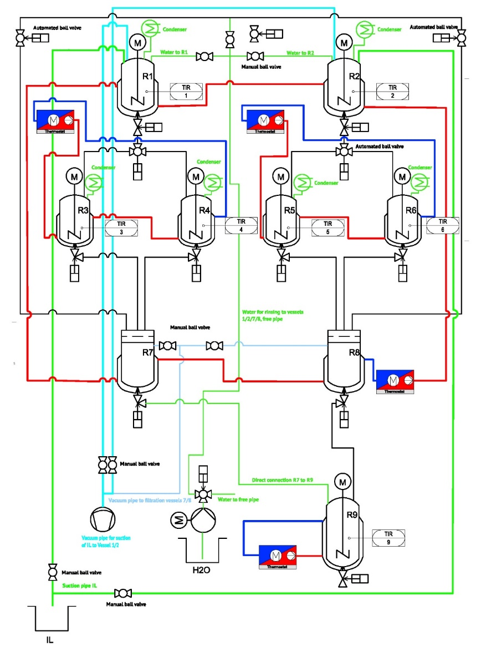
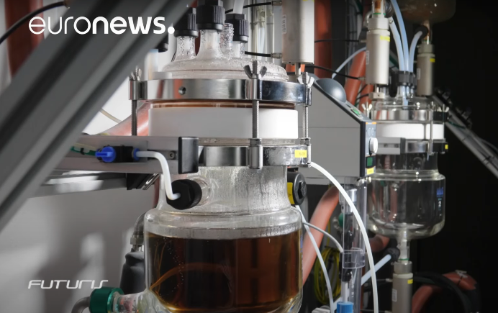
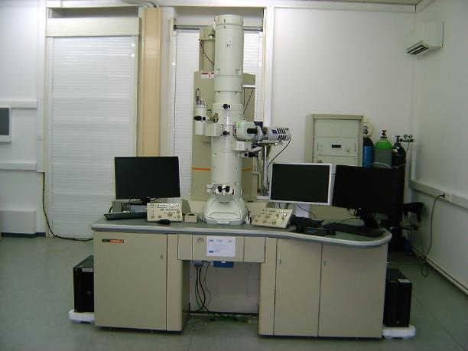
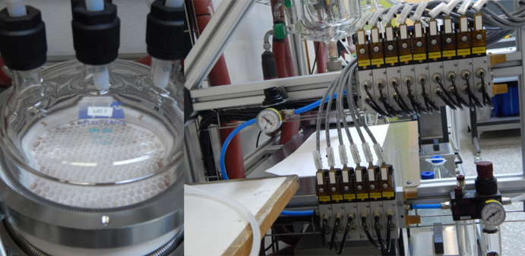

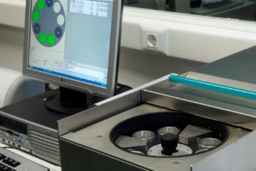
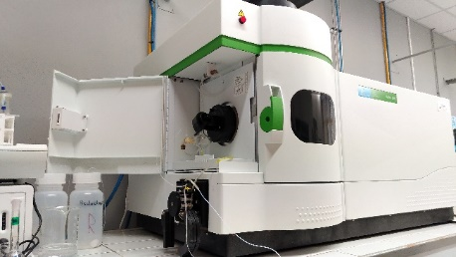
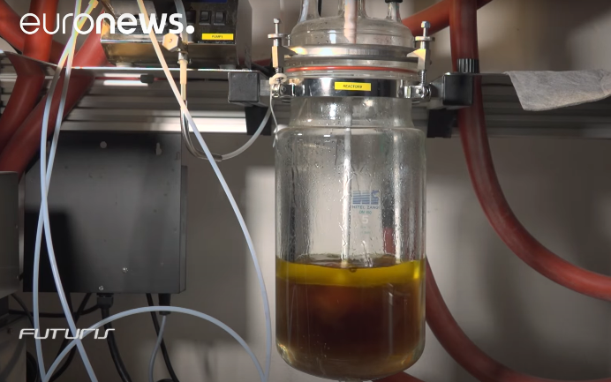
Recovering and re-using critical raw materials from electronics and secondary resources (1/2) - NTUA
Zone 1
Zone 1
Extraction of critical metals and rare earth elements (REE) from raw materials, or secondary resources
Extraction
(up to 220ºC, flow, pH, agitation control )
Scrubbing
Stripping
Physicochemical characterisation
Materials
preparation
Hydrometallurgical metals recovery

Slide 3

Recovering and re-using critical raw materials from electronics and secondary resources (2/2) - NTUA
What?
REEs from bauxite residue
https://www.youtube.com/watch?v=QTn8EhcDeGs
E-waste valorisation
M⁺ recovery from fibers
Metals recovery, ecofriendly reagents evaluation, secondary streams utilisation, selective hazardous materials removal
Where?
Efficient extraction processes, secondary resources utilisation, environmental solutions
Athens, Greece
For whom?
Extractive industries, chemical sector, eco-processing (EPD)
Why?
Integrated services (including preparation and characterisation), fully automated control and monitoring, automated feed through pneumatic valves, suitable for long reaction time, accurate measurements for LCA

Slide 4
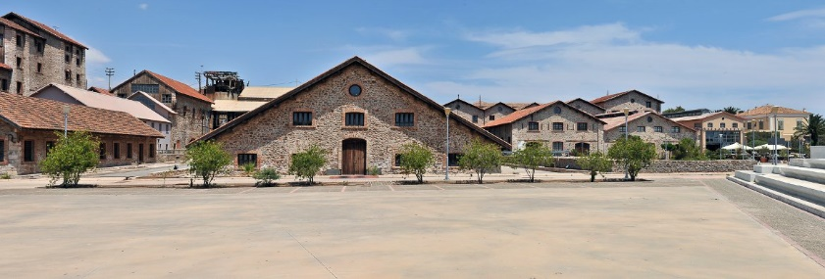
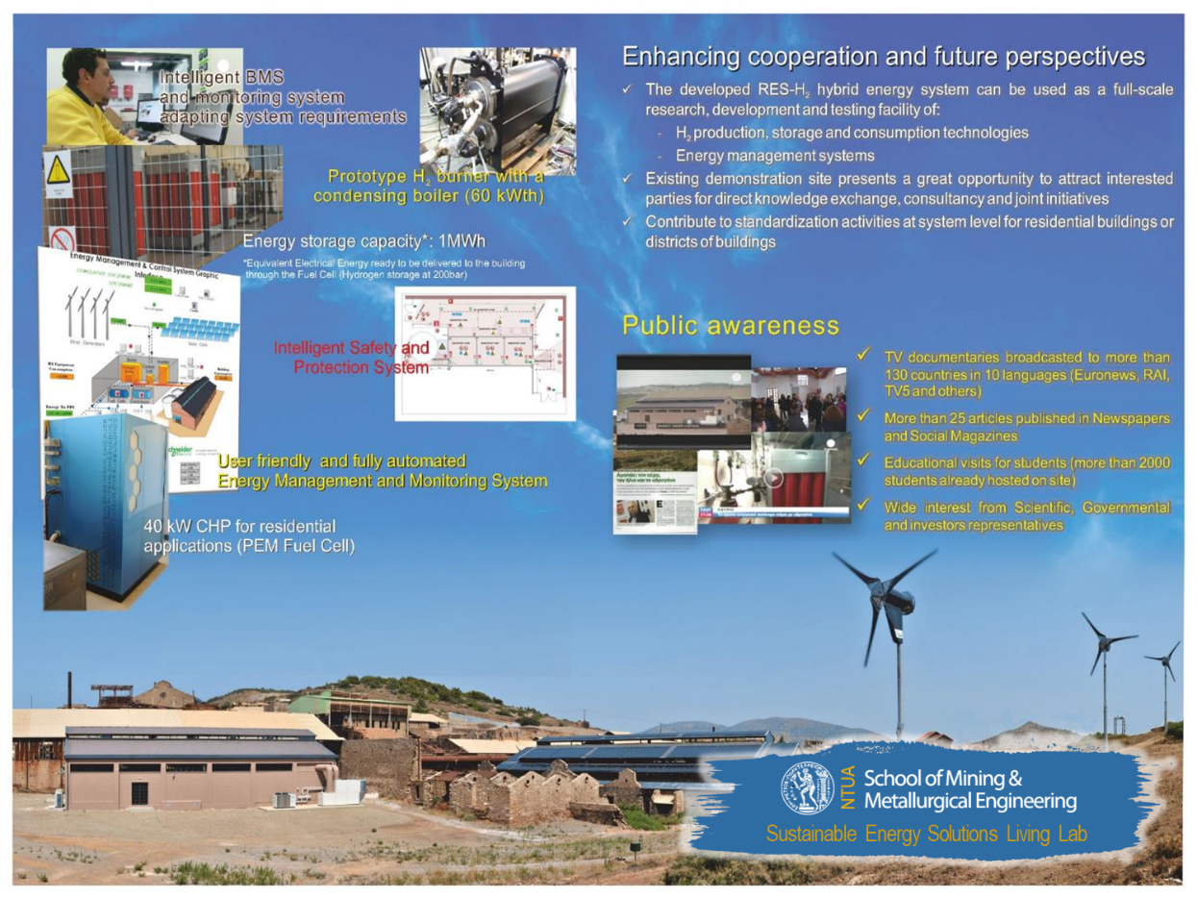
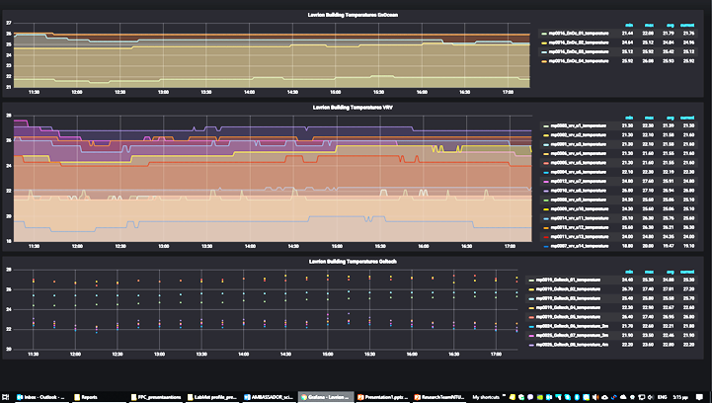
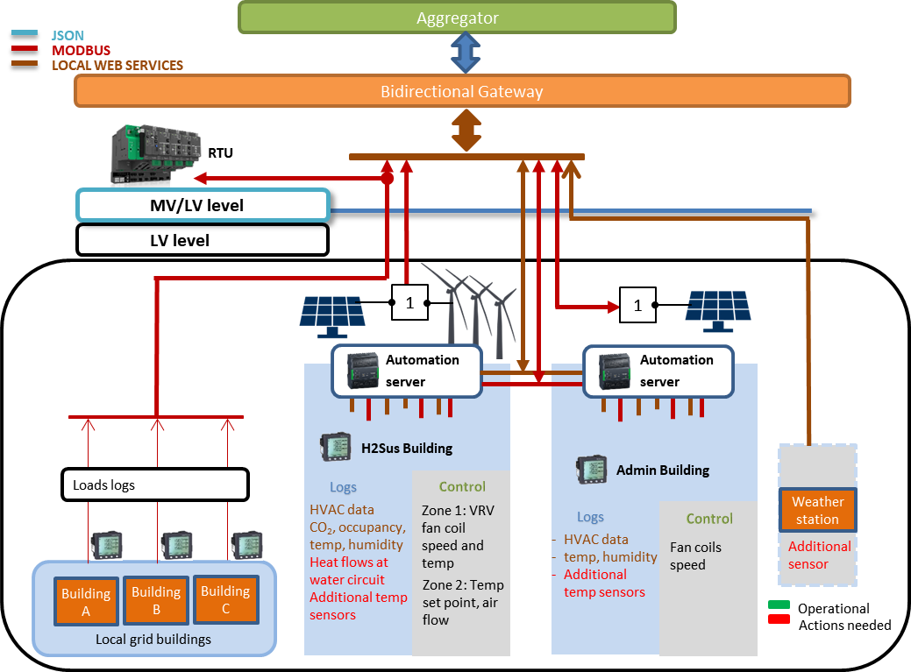
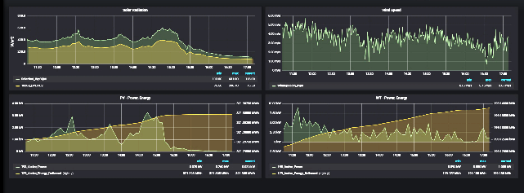
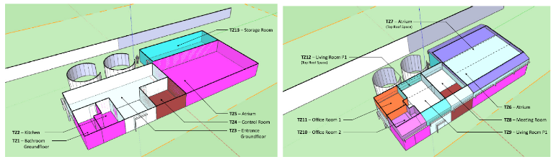
Living Lab to test novel material solutions and products in under real TRL7 application conditions (1/2) - NTUA
Smart grid, demand side flexibility, communication protocols and networks
The living lab enables C2G customers willing to integrate novel circular / carbon neutral materials to energy solutions such as fuel cells; (flexible) photovoltaic products and battery solutions; to test their products under real-live conditions.

Slide 5

Living Lab to test novel material solutions and products in under real TRL7 application conditions (2/2) - NTUA
What?
Coating application for PVs
HVAC and BMS controllers
Aggregator functionalities and secured operation
Energy solutions: onsite RES testing, DSS for energy management, RES penetration, peak demand optimisation, grid flexibility
Where?
Hybrid energy systems, energy communities, decentralised energy systems
Athens, Greece
For whom?
DSO, DSS developers, RES producers, H₂ prototypes, HVAC and building sensors developers, trainees
Why?
Multi monitoring and control system visualised in dashboards, extensive historical data for model training, hosting of non certified prototypes, ATEX II classified area, hosting rooms for onsite training

